Slide 1
General Instruction Review
AI4ALL NLP Group

Slide 2
Comparisons
Supervised vs Unsupervised Learning
Regression vs Classification
Underfitting vs Overfitting

Slide 3
Linear and Logistic Regression
Goal: Predict numerical outputs from previously unseen inputs.

Slide 4
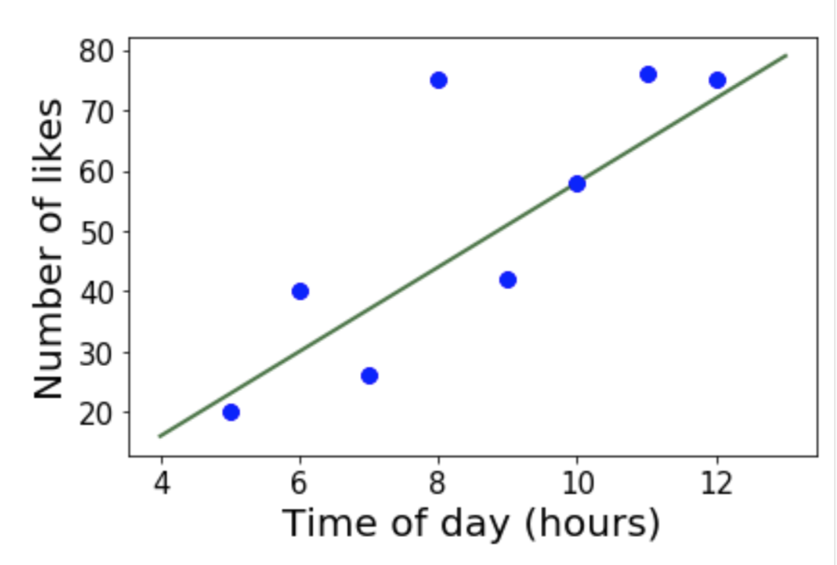

Linear and Logistic Regression
Goal: Predict numerical outputs from previously unseen inputs.
Linear regression:
Models: Linear relationship between inputs and outputs.
Find the line ($\hat{y}=mx+b$) that minimizes error.

Slide 5
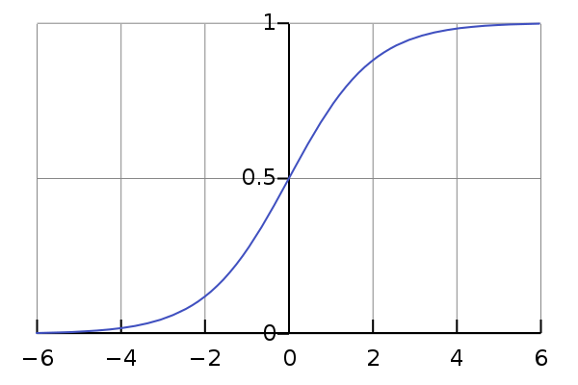
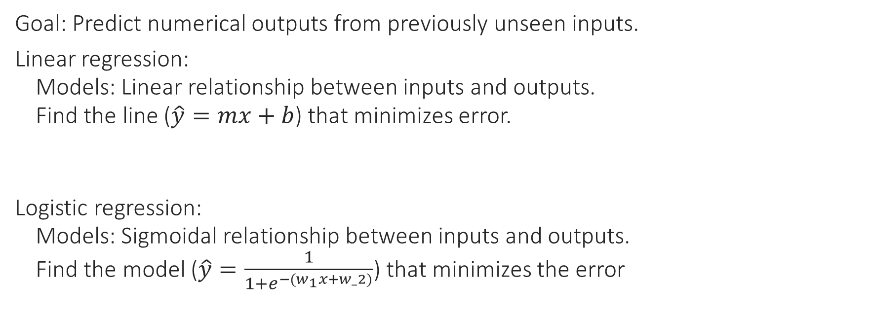
Linear and Logistic Regression
Goal: Predict numerical outputs from previously unseen inputs.
Linear regression:
Models: Linear relationship between inputs and outputs.
Find the line ($\hat{y}=mx+b$) that minimizes error.
Logistic regression:
Models: Sigmoidal relationship between inputs and outputs.
Find the model ($\hat{y}=\frac{1}{1+e^{−(w_{1}x+w_2)}}$) that minimizes the error

Slide 6
Decision Trees
Goal: Classification.

Slide 7
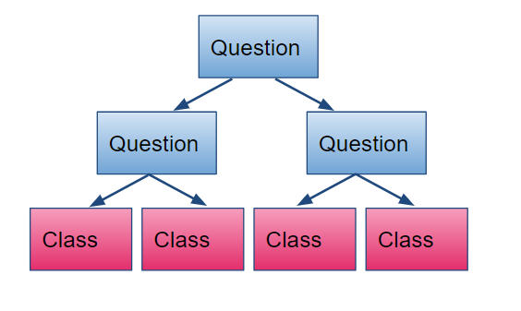
Decision Trees
Goal: Classification.
Method: Create tree of questions to determine classification.

Slide 8
Decision Trees
Goal: Classification.
Method: Create tree of questions to determine classification.
Method: Constructing the Tree:
Select “best split” feature.
Create new node based on this feature.
Separate training dinner based on split.
Repeat until:
Group’s examples have same type.
Group is too small.
Tree is too large.
Create child node representing classification.

Slide 9
Decision Trees
Goal: Classification.
Method: Create tree of questions to determine classification.
Method: Constructing the Tree:
Select “best split” feature: Maximum information gain.
Create new node based on this feature.
Separate training dinner based on split.
Repeat until:
Group’s examples have same type.
Group is too small.
Tree is too large.
Create child node representing classification.

Slide 10
Nearest Neighbors
Goal: Classification.

Slide 11
Nearest Neighbors
Goal: Classification.
Idea: Classify similar nodes similarly.
Nearest neighbors, k-nearest neighbors.

Slide 12
Naïve Bayes
Goal: Classification.

Slide 13
Naïve Bayes
Goal: Classification.
Assumption: Independence.

Slide 14

Naïve Bayes
Goal: Classification.
Assumption: Independence.
Method: Use Bayes’ Rule to find probability of each class, and choose class with highest probability.
Bayes’ Rule: $P\left(A | B\right)=\frac{P(B|A)P(A)}{P(B)}$

Slide 15
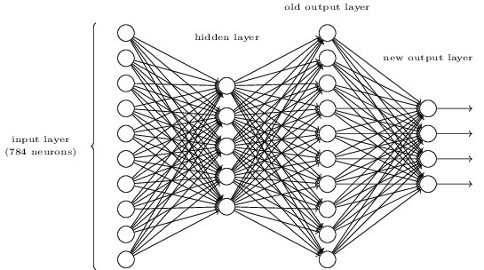
Neural Networks
Structure:
Training: Backward propagation.

Slide 16
K-Means Clustering
Unsupervised Learning.

Slide 17
K-Means Clustering
Unsupervised Learning.
Method:
Pick k random centroids.
Assign each example to the closest centroid.
Recompute the centroids.

Slide 18
Q&A
Intro to Python and CS Concepts
Intro to Machine Learning
Data Exploration and Stats
Linear and Logistic Regression
Decision Trees and Nearest Neighbors
Probability and Naïve Bayes
Unsupervised Learning
Neural Networks
Future of AI

